Slide 1


Slide 2

Understanding Phase 5 Phonics
Phase 5 phonics builds on what children learned in Phases 1-4. By now, they can read and spell words with adjacent consonants.
Previously taught during Year 1, ELS ensures this phase is taught in Reception to provide a strong foundation for reading fluency and spelling accuracy.

Slide 3
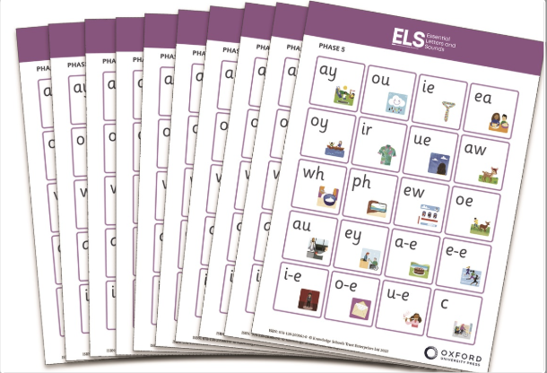




Goals of Phase 5 Phonics
Broaden Knowledge
Extend phonics understanding with new patterns and rules.
Increase Speed
Develop quicker grapheme recognition and recall and build fluency.
Learn Alternatives
Master new graphemes and alternative phonemes.
Build Confidence
Tackle more complex words with growing confidence.

Slide 4
What's New in Phase 5?
Alternative Spellings
Multi-syllabic Words
Children learn different ways to spell the same sound.
Children work with longer words having two or three syllables.
/ai/ in rain
sunset
/ay/ in play
playground
/a-e/ in make
Saturday

Slide 5





Key Phase 5 Skills
Split Digraphs
Reading and spelling words with a-e, e-e, i-e, o-e, u-e.
Sound Recognition
Understanding that same sounds can have different spellings.
Grapheme Choice
Selecting appropriate letter patterns when spelling words.
Quick Recall
Recognising and recalling graphemes more rapidly.

Slide 6
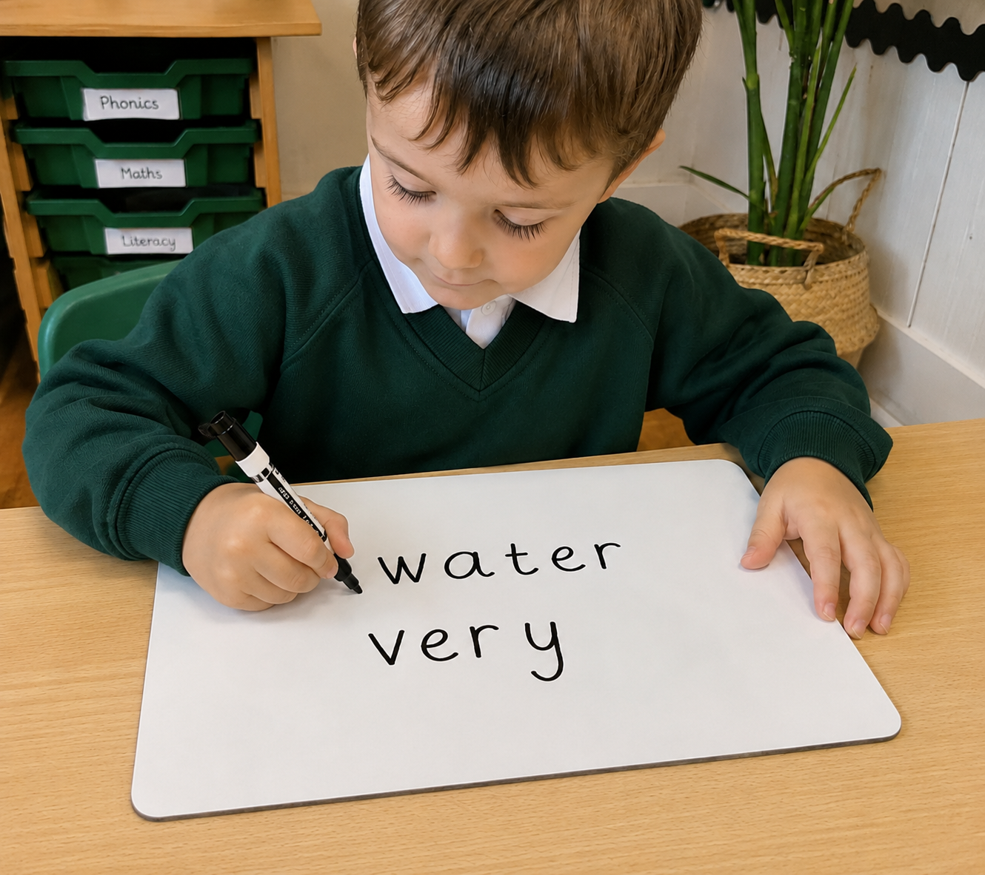
HRS Words in Phase 5
oh their people Mr Mrs your ask should very
would could asked house mouse water want
Learning Strategies
Regular practice- reading and spelling
Word walls
Memory games
Color-coding systems

Slide 7








Signs of Phase 5 Mastery
Spelling Accuracy
Correctly writing multi-syllable words
Reading Independence
Growing confidence with unfamiliar texts and alien words
Sound-Letter Recognition
Quick recall of all taught graphemes
Phonics Application
Using phonics as primary decoding strategy

Slide 8








Resources and Next Steps
Home Practice
Decodable Books
HRS spell words both spelling and reading to overlearn and embed.
The books we send home are matched to the teaching week. This enables the children to put their learning into practise.
Revisit previous taught GPCs
Digital Resources
Revisit previously taught GPCs through flash cards etc.
Explore apps and games that reinforce phonics learning.

Slide 9

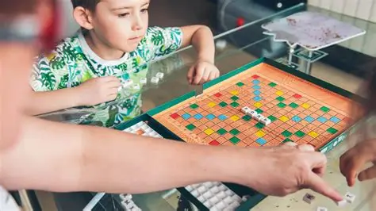

Supporting Your Child at Home
Daily Reading
Word Games
Word Banks
Use decodable books at the appropriate level. Focus on phonics-based reading.
Play games focusing on alternative pronunciations and spelling patterns.
Create collections of words with similar spelling patterns.

