Slide 1

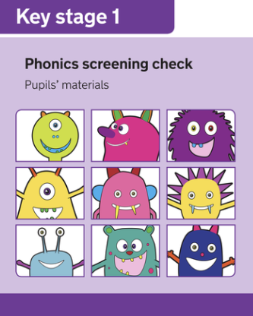
Click here to listen to Mrs Adams
Understanding the Phonics Screening Check
A guide for parents of Year 1 children

Slide 2
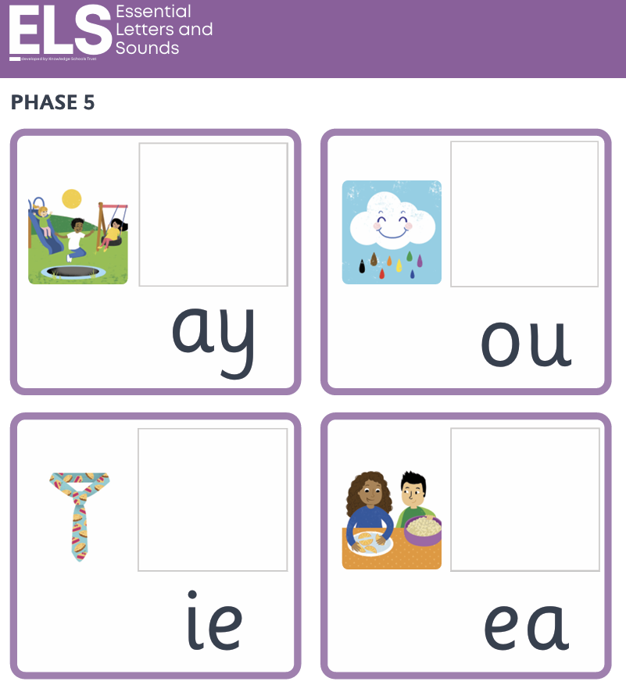

THE BASICS
What is Phonics and Why Does it Matter?
Phonics teaches children to read by connecting letters to the sounds they make. Children learn to recognise individual letter sounds — and combinations like 'sh' or 'oo' — then blend them together to decode words.
Blending sounds is the critical first step towards becoming a confident, fluent reader.

Slide 3
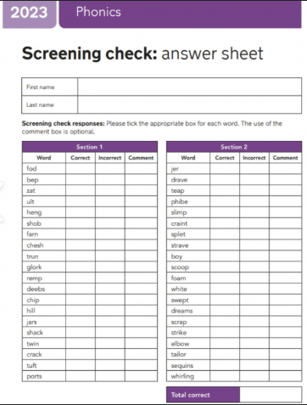
What is the Phonics Screening Check?
Who takes it?
What is it for?
All Year 1 children participate in the screening check.
Confirms whether phonic decoding skills are at an age-appropriate standard.
Why does it matter?
Helps identify children who may benefit from extra reading support early on.

Slide 4

HOW IT WORKS
Inside the Check
Word Mix
Pseudo-Word Cue
Pair each pseudo-word with a friendly cartoon creature image.
Include real words alongside phonically decodable pseudo-words.
What are pseudo-words? These are invented, phonically decodable words (like 'vop' or 'strom') that test whether a child can decode sounds rather than rely on memory. Each one is accompanied by a picture of an imaginary creature to signal it is a made-up word.
Materials Prep
One-to-One Check
Prepare 40 words split into two lists of twenty.
Teacher-led, calm 10-minute session per child.
The check is calm and conversational — children are told in advance that some words are made-up, so there is no need to worry about the nonsense words. This is a process the children are familiar with as our half-termly assessments follow a similar routine to the screening check.

Slide 5
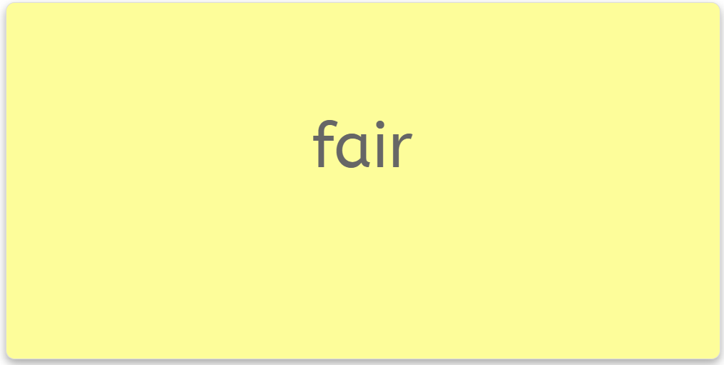
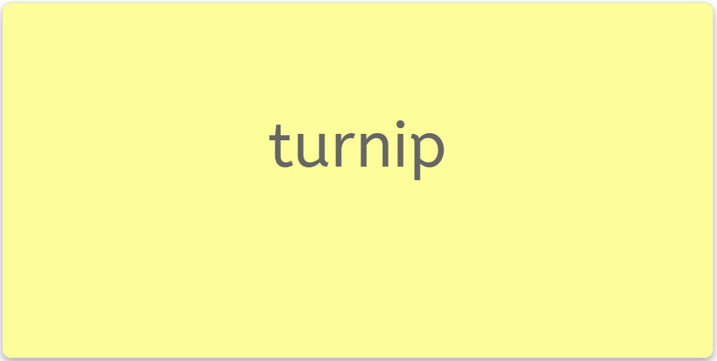

Decoding Words:
Real Words & Pseudo-Words
Pseudo-words level the playing field — they ensure children are truly decoding sounds, not simply recognising words they have memorised. Every child faces the same challenge.

Slide 6
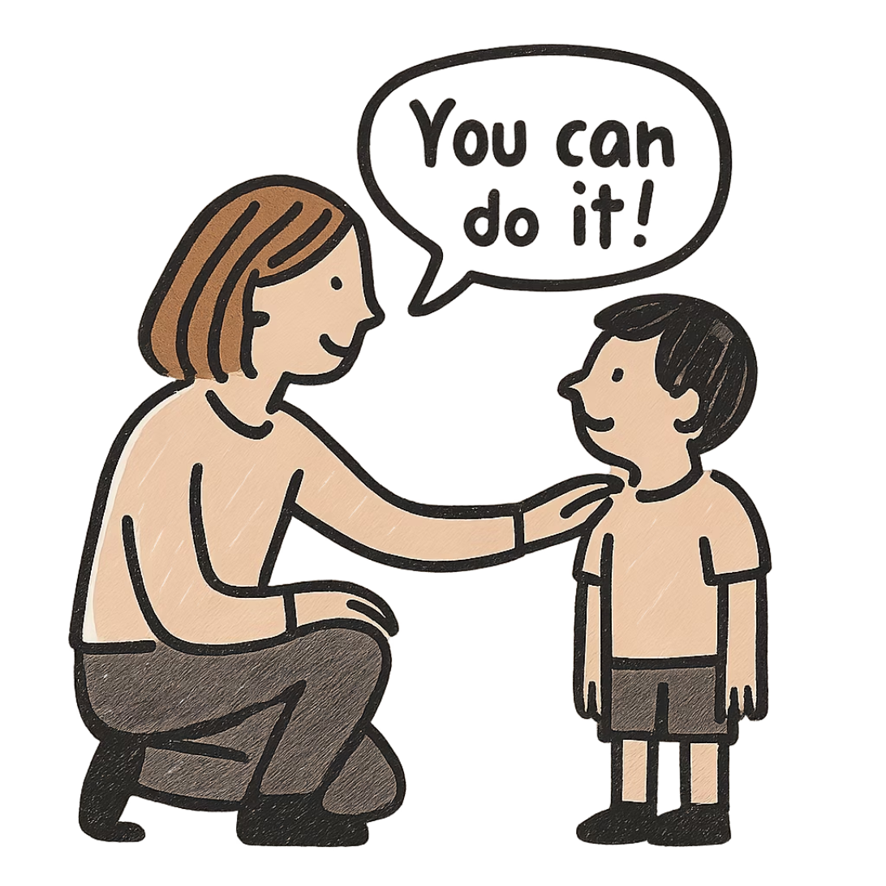
SUPPORT & NEXT STEPS
What if a Child Doesn't Meet the Standard?
Not reaching the expected standard is not a cause for alarm — it is simply useful information. Here is what happens next:
1
Targeted Support
2
Retake in Year 2
3
No Child Left Behind
The school will put additional phonics support in place straight away.
Children will have the opportunity to retake the check the following year.
The aim is to catch any gaps early, before they affect wider reading progress.

Slide 7

FOR PARENTS
How Can You Support Your Child?
Read Together
Sound it Out
Share books regularly — making reading enjoyable is the single greatest gift you can give.
Encourage your child to blend sounds in unfamiliar words rather than guessing from pictures.
Talk About Words
Ask the Teacher
Discuss the meaning of new words you encounter — vocabulary and decoding go hand in hand.
If you need any advice or if you have any concerns, please get in touch. I am happy to help in any way I can.

Slide 8
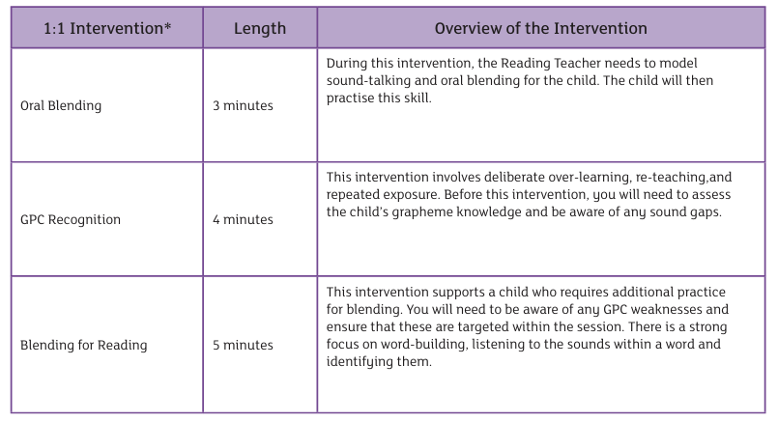

RESULTS
How Are the Results Used?
Results are a professional tool for teachers, not a judgement of your child. We will use them to make practical decisions about support and resourcing moving forward.
You will always be informed of your child's individual result and what it means for their next steps.

Slide 9


A Positive Step for Reading Success
The Phonics Screening Check is a supportive, low-pressure assessment designed to help every child thrive. With your encouragement at home and expert guidance from school, your child has everything they need to build a lifelong love of reading.
Strong Foundations
School Support
Phonics gives children the tools to decode any word they encounter.
We use the assessment data to ensure your children have the skills they need.
Your Role
Listening to your child read at home, with a little and often approach, is the most powerful thing you can do.

